Slide 1
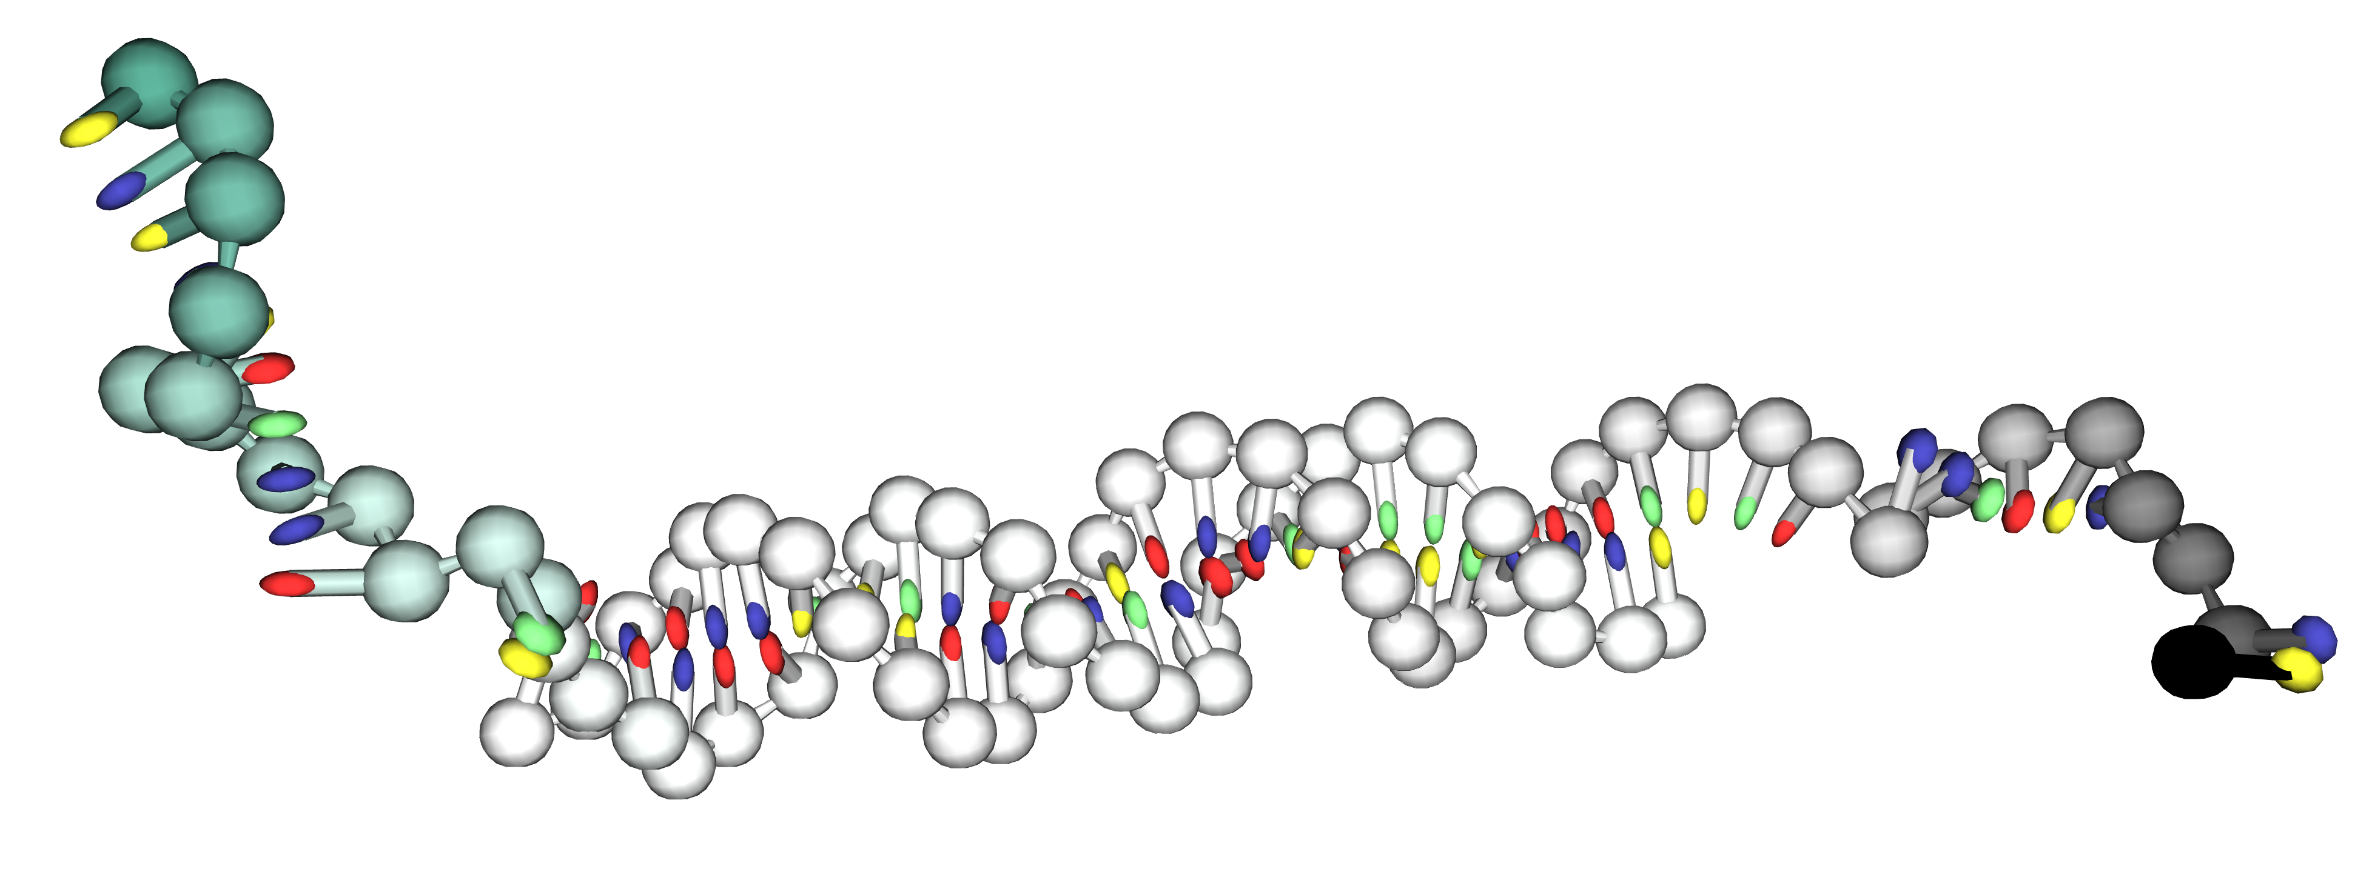
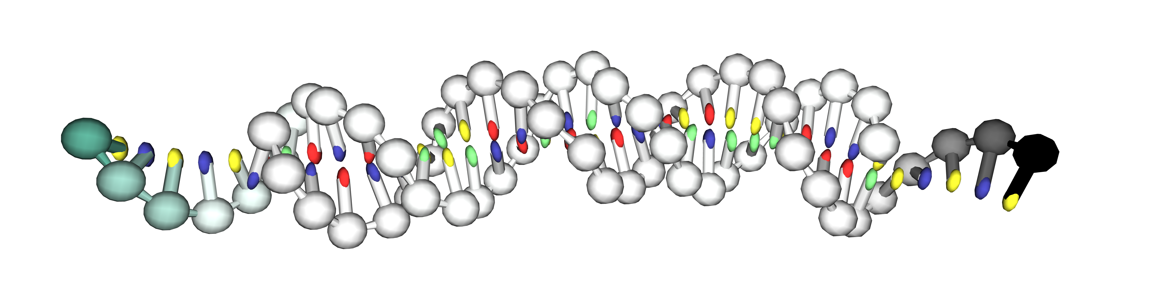
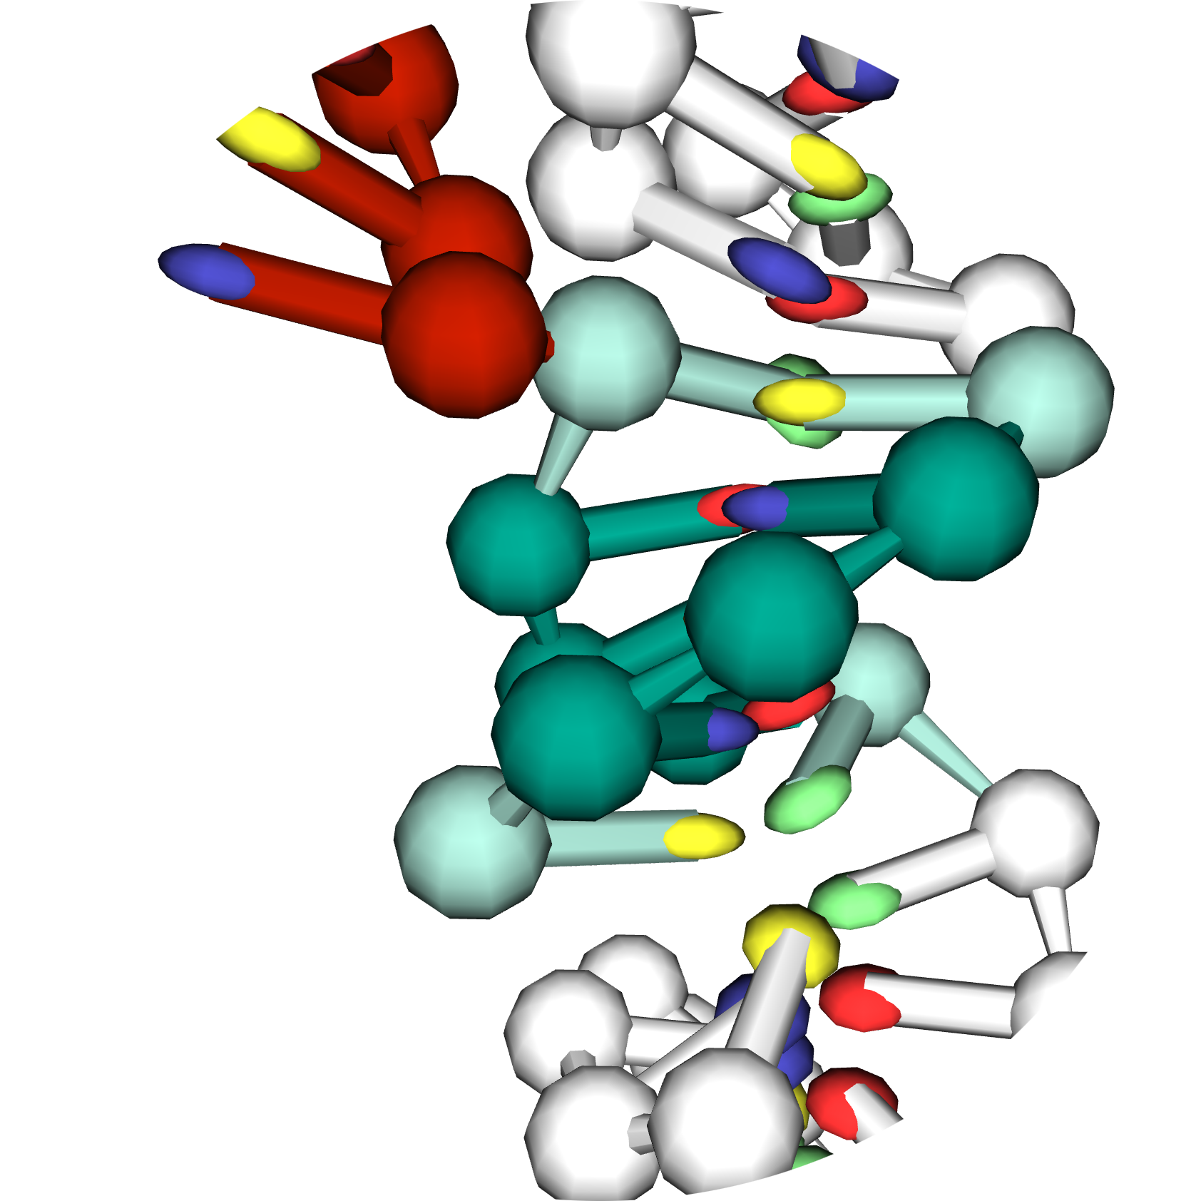
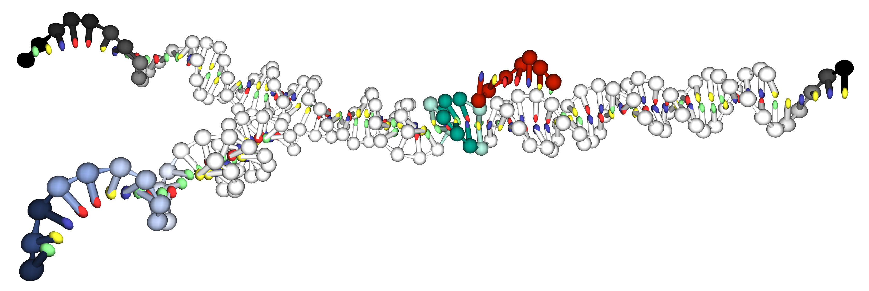
LS12-2
3’
5’
a)
AGATAAGCGTACTGTAAGTGGCATTCGCTAACTGAGAG
GAGAGTCAATCGTCTATTCGCATGACATTCACCGTAAG
5’
3’
LS12-1
LS5-2
b)
3’
5’
AGATAAGCGTACTGTAAGTGGCATTCGAGAG
GAGAGTCTATTCGCATGACATTCACCGTAAG
5’
3’
5’
LS5-1
3’
CGATTGACTCTC
5’
GAAGCTGCCAGTAC
Y1
AGTTAGC
CTTCGACGGTCATG
LS5-2
5’
Y2
CAATCCTGTCGCAC
CTCTC
AGATAAGCGTACTGTAAGTGGCATTCGAGAG
d)
c)
GTTAGGACAGCGTG
GAGAGTCTATTCGCATGACATTCACCGTAAG
3’
LS5-1
GGAGACTAGATCAT
Y3
CCTCTGATCTAGTA
3’
V*_{stack}
V*_{b,b}
V_{b,b}
CGATTGACTCTC
V_{HB}
V_{cr.stack}
5’
V_{coax.stack}

